Slide 1
Whose baby smells the worst?
Case et al. 2006. Evolution and Human Behavior

Slide 2
Mood during a half-marathon run
Awesome!
Feeling strong
Meh…
Mood
Ugh
Suffering
Despair
Finish

Slide 3
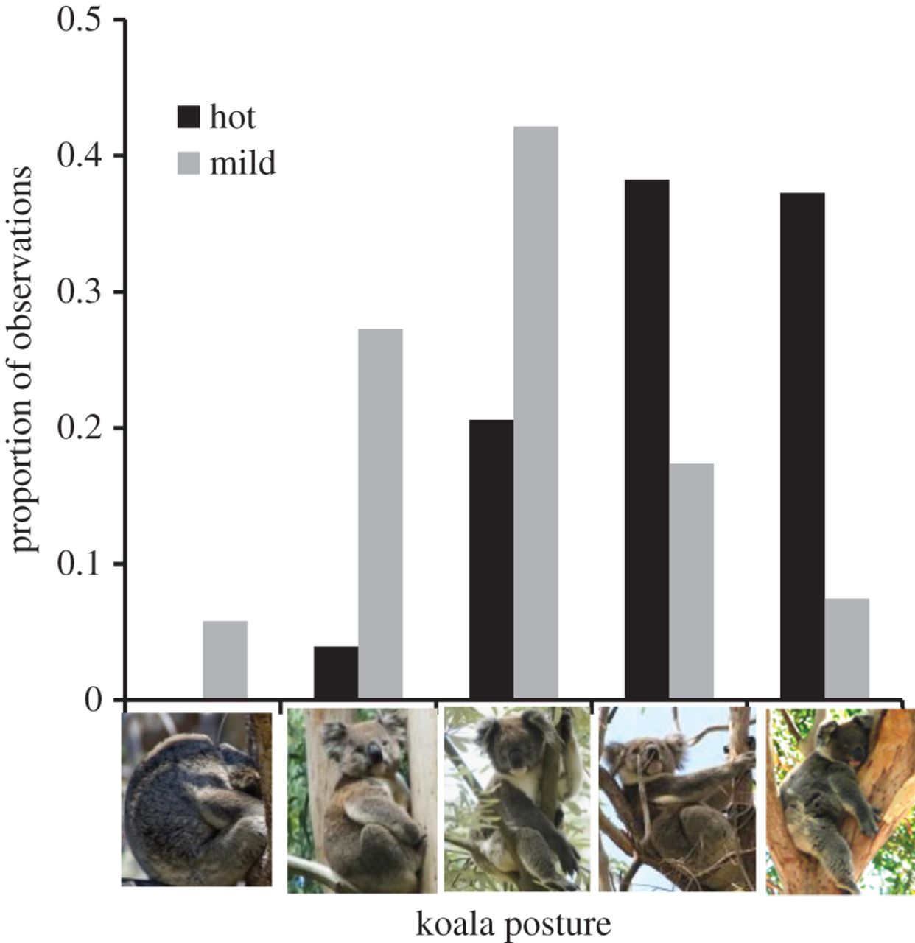
Effect of temperature on koala posture
Briscoe et al. 2014. Biology Letters

Slide 4
Climate driven changes in New England butterfly populations
Increasing
Northern species
Population trajectory
No Change
Southern species
Decreasing
Region 4
Region 2
Region 1
Region 3
Region 5
After Breed et al. 2012. Nature Climate Change

Slide 5
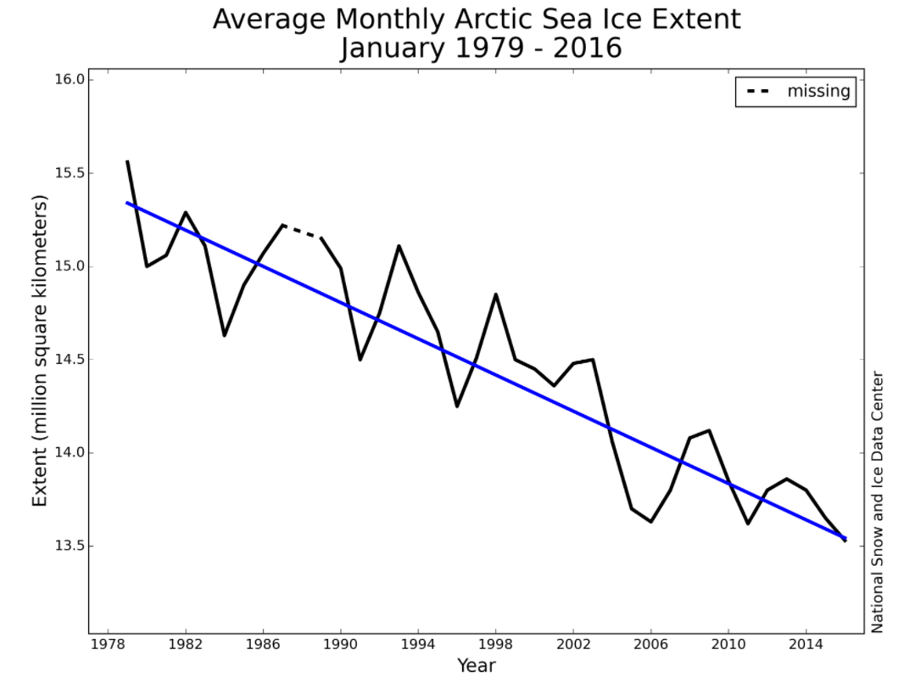

Slide 7
Graphs

Slide 8
Meyer-Rochow and Gal 2013. Polar Biology

